Slide 1
Regression Using Single-Neuron Perceptron
生醫光電所 吳育德
Paolo Perrotta, Programming Machine Learning: From Coding to Deep Learning (2020)

Slide 2
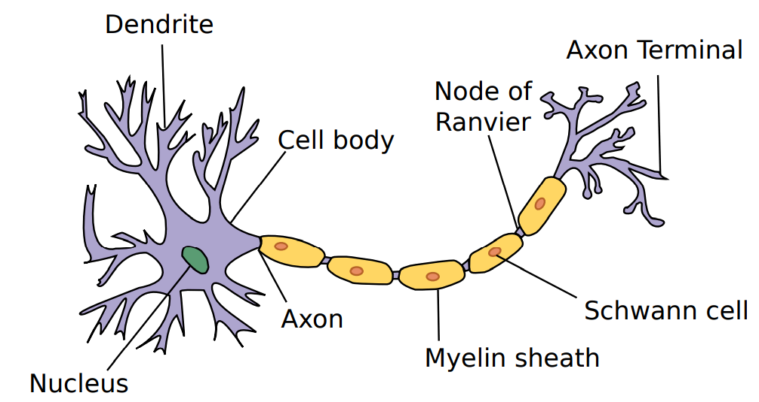
A biological neuron
Output
Input

Slide 3
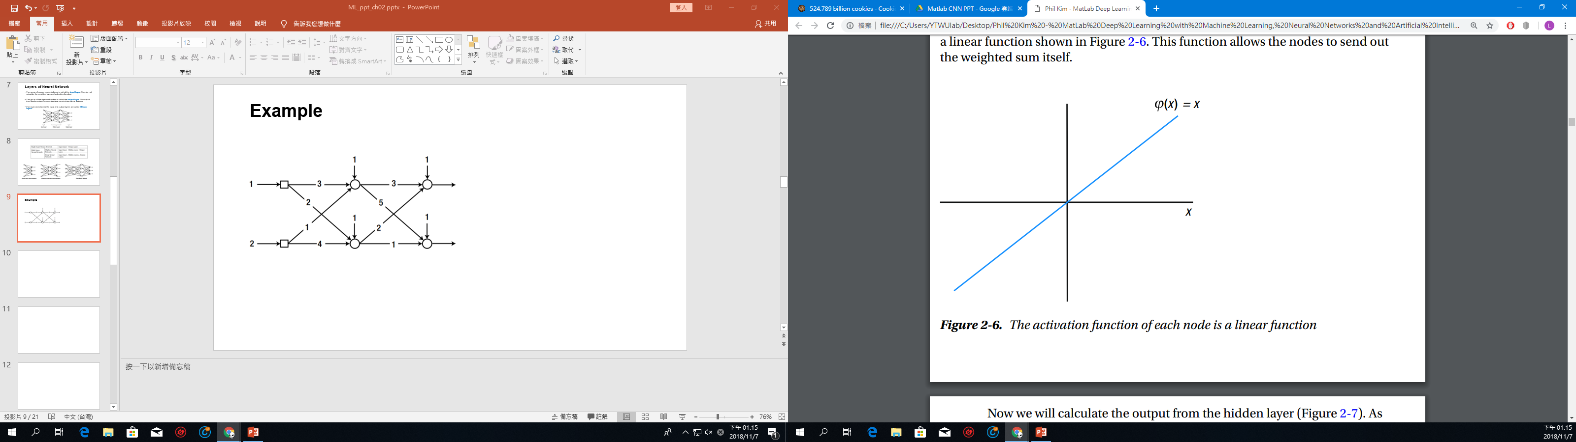

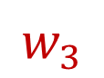
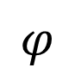
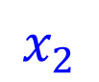
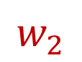
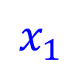
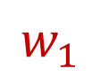
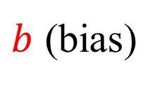
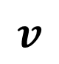
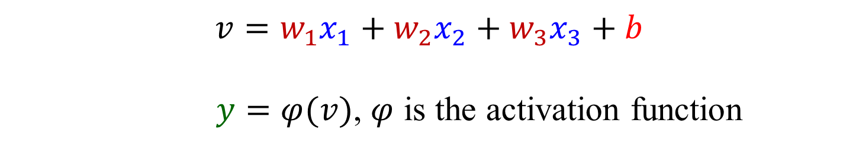
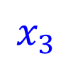
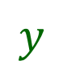
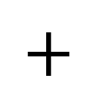
A simplified model receives three inputs
$b$ (bias)
$$x_{1}$$
$$φ$$
$$w_{1}$$
$$v$$
$$w_{2}$$
$$+$$
$$y$$
$$x_{2}$$
$$w_{3}$$
$$x_{3}$$
$$v=w_{1}x_{1}+w_{2}x_{2}+w_{3}x_{3}+b$$
$y=φ(v)$, $φ$ is the activation function

Slide 4
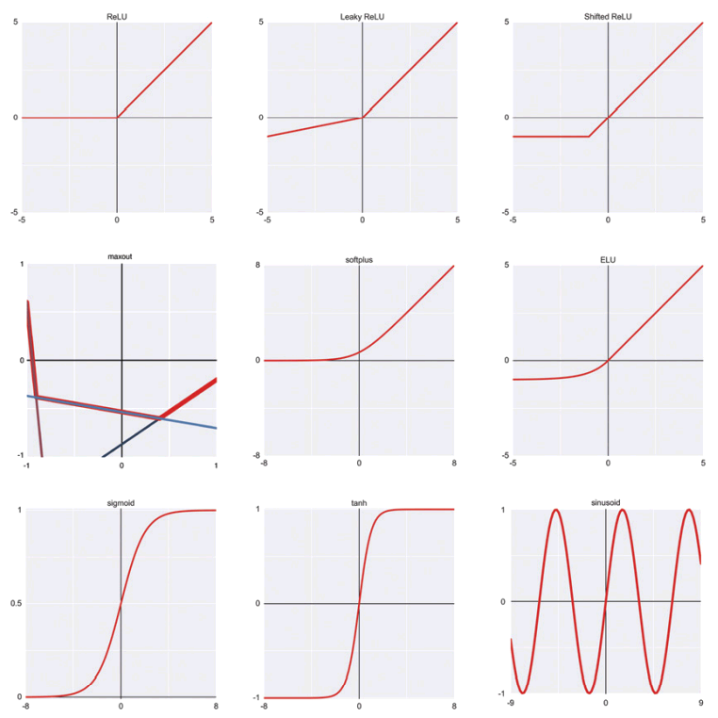
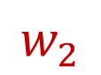
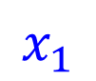

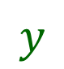
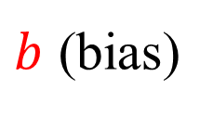
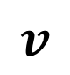
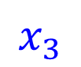
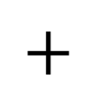

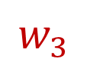
Activation Function Gallery
$b$ (bias)
$$x_{1}$$
$$w_{1}$$
$$v$$
$$y$$
$$w_{2}$$
$$+$$
$$x_{2}$$
$$w_{3}$$
$$x_{3}$$
Andrew Glassner - Deep Learning_ A Visual Approach-No Starch Press (2021)

Slide 5
Outline
Use linear regression to predict one variable from another.
Upgrade the learning program with a faster and more efficient algorithm: gradient descent.
Implement multiple linear regression with multiple inputs using gradient descent, least square loss, and maximal likelihood
Nonlinear regression
Determine the optimal order of regression model using cross validation

Slide 6

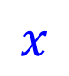


Perceptron
$b$ (bias)
$$φ$$
$$w$$
$$v$$
$$x$$
$$+$$
$$y$$
$$v=xw+b$$
$y=φ(v)$, $φ$ is the activation function

Slide 7
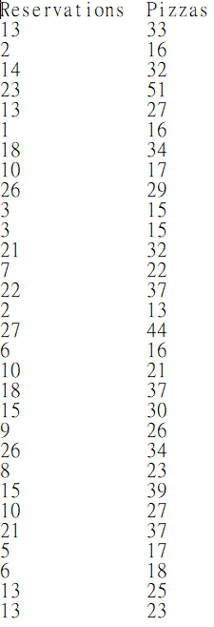
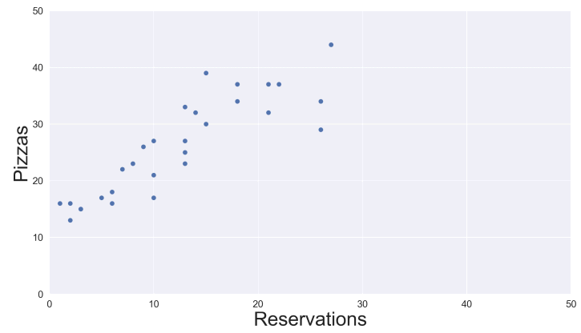
Supervised Pizza
Roberto dreams of a program that looks at historical data, grasps the relation between reserved seats and pizzas, and uses it to forecast tonight’s pizza sales from today’s reservations.
We can solve Roberto’s pizza forecasting problem by training a supervised learning algorithm with a bunch of labeled examples.

Slide 8
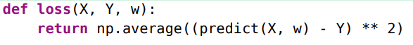
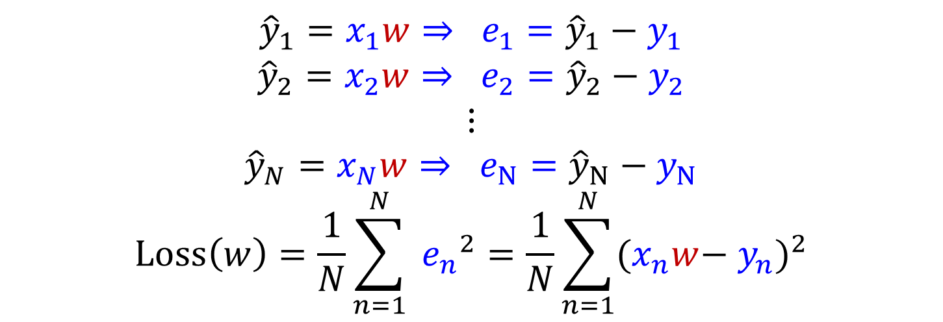

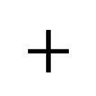


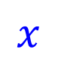
When $b=0$ and $y=v$: Regression
$$w$$
$$x$$
$$+$$
$$\hat{y }, e=\hat{y}−y$$
$${\hat{y}}_{1}=x_{1}w⇒ e_{1}={\hat{y}}_{1}−{ y}_{1}$$
$${\hat{y}}_{2}=x_{2}w⇒ e_{2}={\hat{y}}_{2}−{ y}_{2}$$
$$⋮$$
$${\hat{y}}_{N}=x_{N}w⇒ e_{N}={\hat{y}}_{N}−{ y}_{N}$$
$$Loss\left(w\right)=\frac{1}{N}\sum_{n=1}^{N}{{{ e}_{n}}^{2}}=\frac{1}{N}\sum_{n=1}^{N}{{(x_{n}w−{ y}_{n})}^{2}}$$

Slide 9
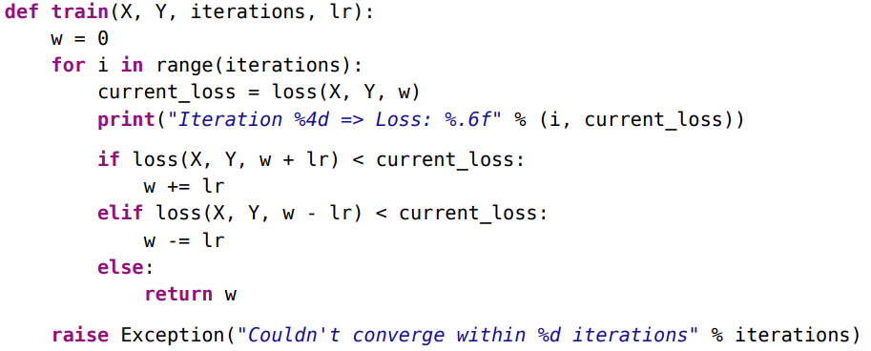
Iterative algorithm

Slide 10
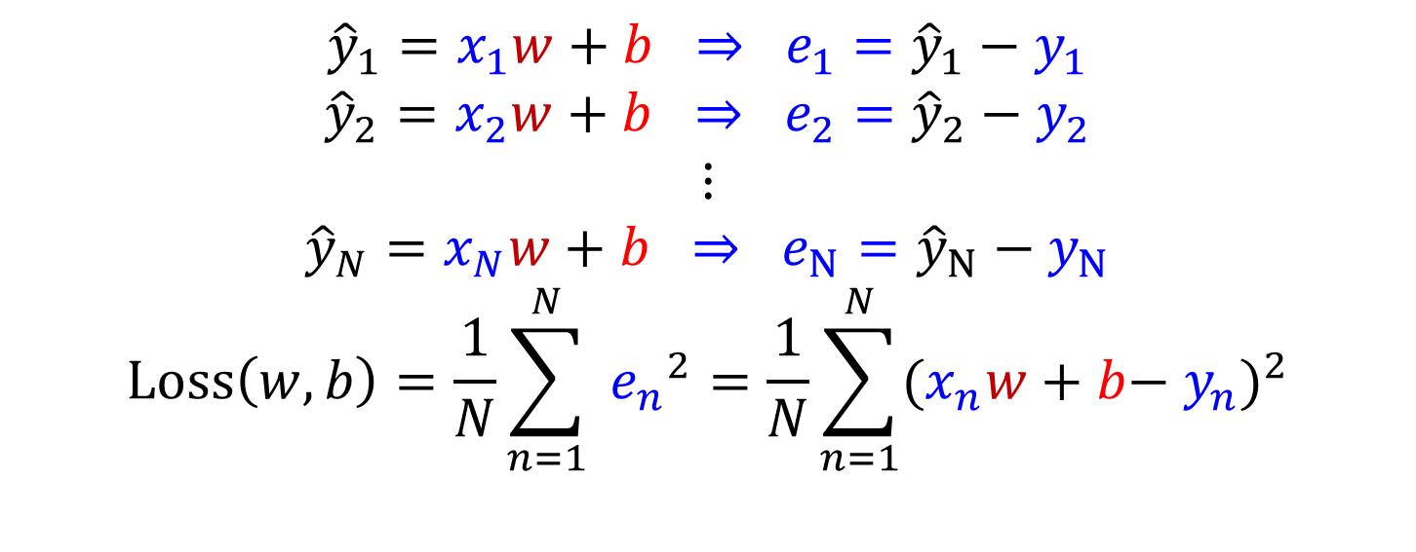

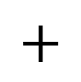


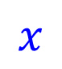

When $b≠0$ and $y=v$: Regression
$b$ (bias)
$$w$$
$$x$$
$$+$$
$$\hat{y }, e=\hat{y}−y$$
$${\hat{y}}_{1}=x_{1}w+b ⇒ e_{1}={\hat{y}}_{1}−{ y}_{1}$$
$${\hat{y}}_{2}=x_{2}w+b ⇒ e_{2}={\hat{y}}_{2}−{ y}_{2}$$
$$⋮$$
$${\hat{y}}_{N}=x_{N}w+b ⇒ e_{N}={\hat{y}}_{N}−{ y}_{N}$$
$$Loss\left(w,b\right)=\frac{1}{N}\sum_{n=1}^{N}{{{ e}_{n}}^{2}}=\frac{1}{N}\sum_{n=1}^{N}{{(x_{n}w+b−{ y}_{n})}^{2}}$$

Slide 11
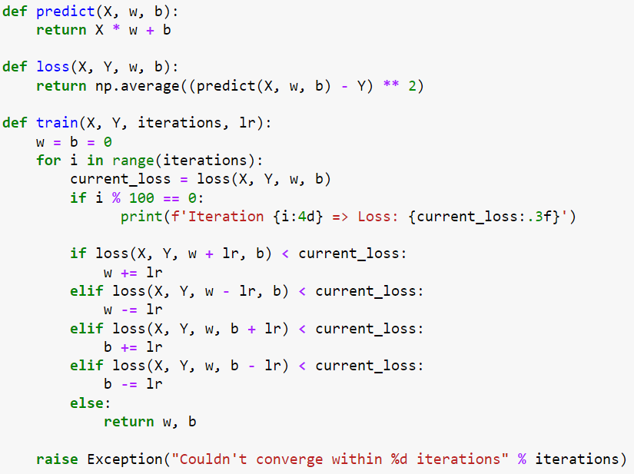

Slide 12
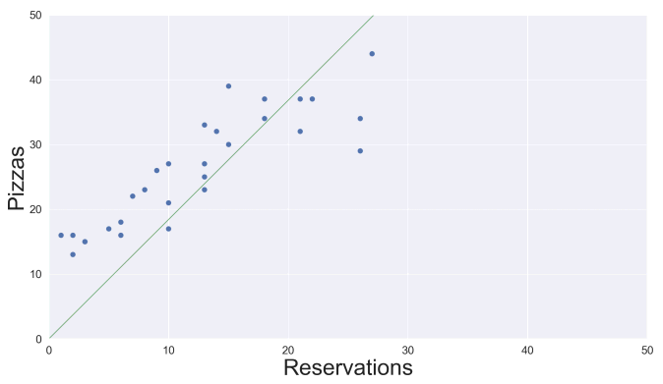
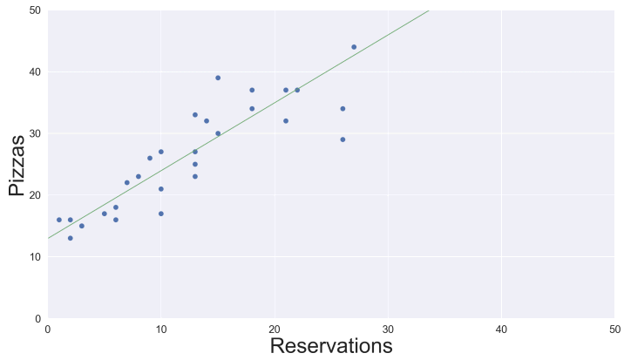
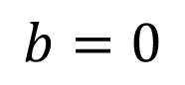
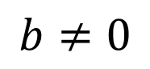
Regression Results
$$b=0$$
$$b≠0$$

Slide 13
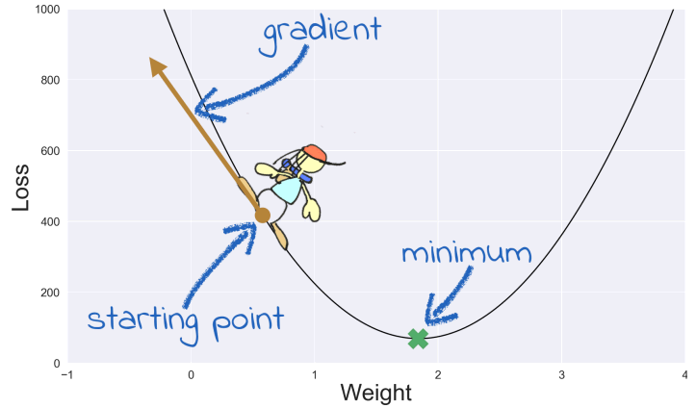
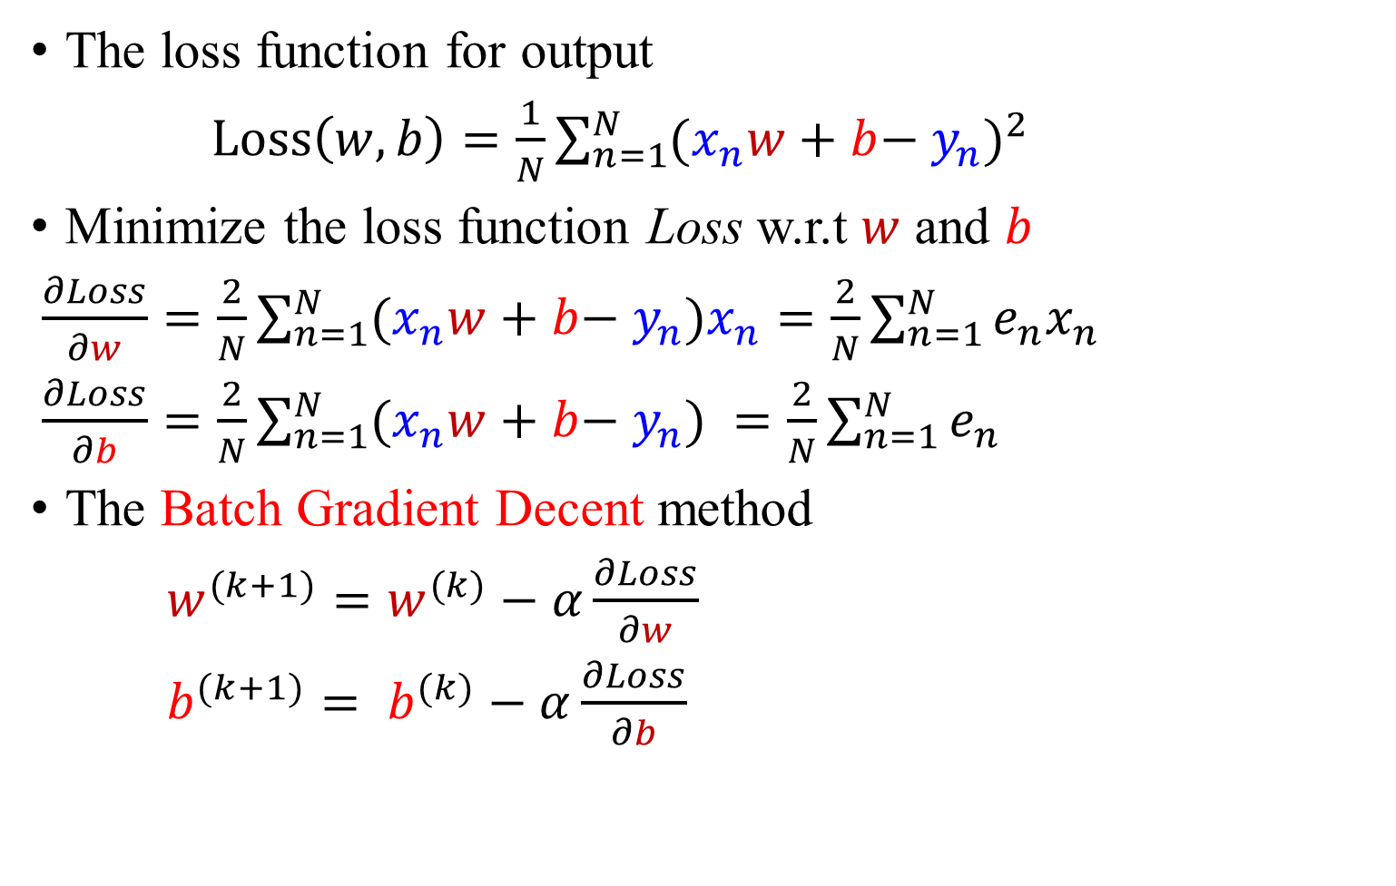
Minimize Mean Squared Error Using Gradient Descent
The loss function for output
$Loss\left(w,b\right)=\frac{1}{N}\sum_{n=1}^{N}{{(x_{n}w+b−{ y}_{n})}^{2}}$
Minimize the loss function Loss w.r.t $w$ and $b$
$\frac{∂Loss}{∂w}=\frac{2}{N}\sum_{n=1}^{N}{(x_{n}w+b−{ y}_{n})x_{n}}=\frac{2}{N}\sum_{n=1}^{N}{e_{n}x_{n}}$
$\frac{∂Loss}{∂b}=\frac{2}{N}\sum_{n=1}^{N}{(x_{n}w+b−{ y}_{n}) }=\frac{2}{N}\sum_{n=1}^{N}{e_{n}}$
The Batch Gradient Decent method
$w^{(k+1)}=w^{(k)}−α\frac{∂Loss}{∂w}$
$b^{(k+1)}= b^{(k)}−α\frac{∂Loss}{∂b}$

Slide 14
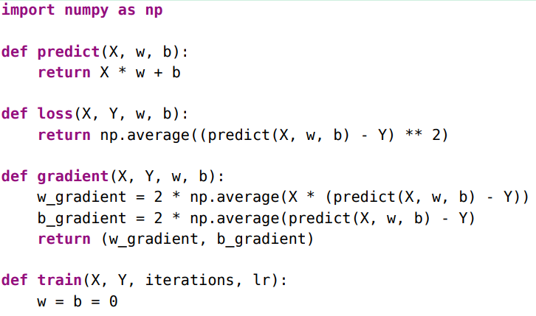
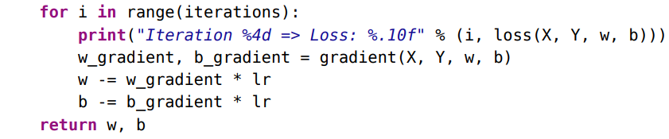
Minimize Mean Squared Error Using Gradient Descent

Slide 15
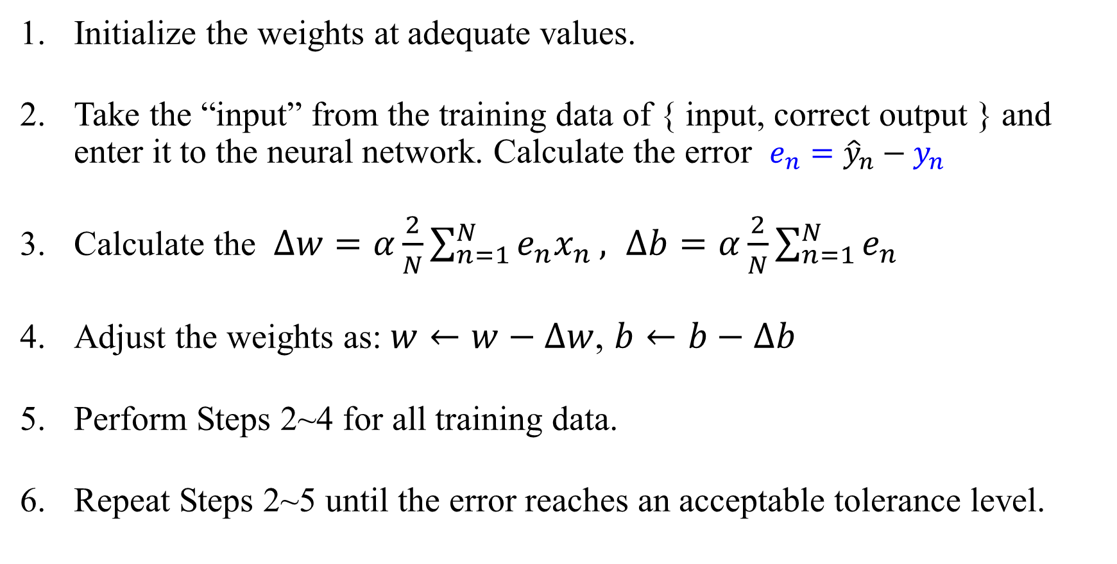
Algorithm
Initialize the weights at adequate values.
Take the “input” from the training data of { input, correct output } and enter it to the neural network. Calculate the error $e_{n}={\hat{y}}_{n}−{ y}_{n}$
Calculate the $∆w=α\frac{2}{N}\sum_{n=1}^{N}{e_{n}x_{n}}, ∆b=α\frac{2}{N}\sum_{n=1}^{N}{e_{n}}$
Adjust the weights as: $w←w−∆w$, $b←b−∆b$
Perform Steps 2~4 for all training data.
Repeat Steps 2~5 until the error reaches an acceptable tolerance level.

Slide 16
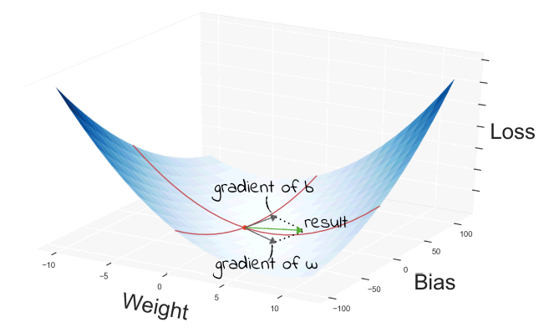
Minimize Mean Squared Error Using Gradient Descent

Slide 17
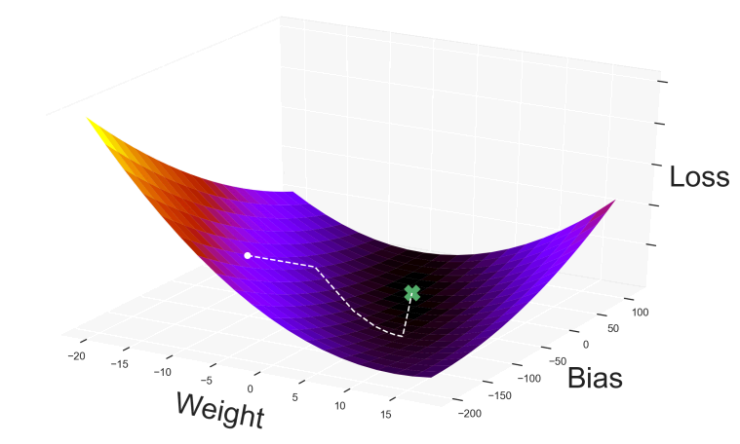
Minimize Mean Squared Error Using Gradient Descent

Slide 18
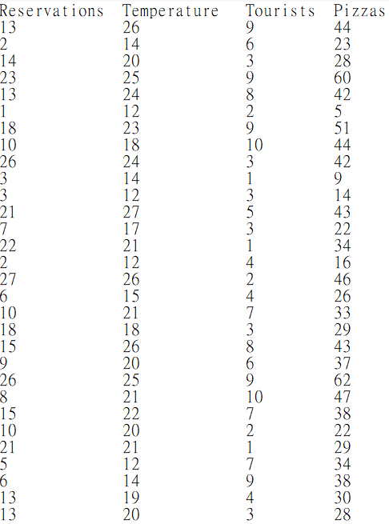
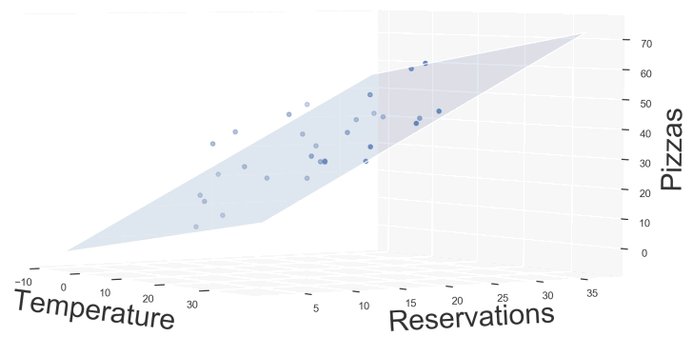
Hyperspace: Multiple inputs, single output

Slide 19

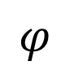
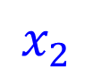










Hyperspace: Multiple inputs, single output
$b$ (bias)
$$x_{1}$$
$$φ$$
$$w_{1}$$
$$v$$
$$w_{2}$$
$$+$$
$y$ (Multiple regression)
$$x_{2}$$
$$w_{3}$$
$$x_{3}$$
$0 or 1$ (Binary classification)
$$v=x_{1}w_{1}+x_{2}w_{2}+x_{3}w_{3}+b=xw+b$$
where $x=\left[x_{1} x_{2} x_{3}\right]$, $w=\left[\begin{matrix}w_{1} \\ w_{2} \\ w_{3}\end{matrix}\right]$
$y=φ(v)$, $φ$ is the activation function

Slide 20



$$x_{1} x_{2} x_{3}$$
$$y$$
Features
$$X=$$
Samples

Slide 21

When $b=0$ and $y=v$: Multiple Regression
$${\hat{y}}_{1}=\left[x_{11} x_{12} x_{13}\right]\left[\begin{matrix}w_{1} \\ w_{2} \\ w_{3}\end{matrix}\right]⇒ e_{1}={\hat{y}}_{1}−{ y}_{1}$$
$${\hat{y}}_{2}=\left[x_{21} x_{22} x_{23}\right]\left[\begin{matrix}w_{1} \\ w_{2} \\ w_{3}\end{matrix}\right]⇒ e_{2}={\hat{y}}_{2}−{ y}_{2}$$
$$⋮$$
$${\hat{y}}_{N}=\left[x_{N1} x_{N2} x_{N3}\right]\left[\begin{matrix}w_{1} \\ w_{2} \\ w_{3}\end{matrix}\right]⇒ e_{N}={\hat{y}}_{N}−{ y}_{N}$$
$$Loss\left(w\right)=\frac{1}{N}\sum_{n=1}^{N}{{({\hat{y}}_{n}−{ y}_{n})}^{2}}, {\hat{y}}_{N×1}=X_{N×3}w_{3×1}$$

Slide 22




That dangling comma is NumPy’s way of saying that these arrays have just one dimension. They are “array,” as opposed to “matrix.”
The ‘ -1 ’ in y.reshape(-1, 1) means that if one dimension is -1, then NumPy will set it to whatever makes the other dimensions fit.

Slide 23


Minimize Mean Squared Error Using Gradient Descent
The loss function for output
$Loss\left(w\right)=\frac{1}{N}\sum_{n=1}^{N}{{(x_{n1}w_{1}+x_{n2}w_{2}+x_{n3}w_{3}−{ y}_{n})}^{2}}=\frac{1}{N}\sum_{n=1}^{N}{e_{N}^{2}}$
Minimize the loss function Loss w.r.t $w_{1}, w_{2}$ and $w_{3}$
$\frac{∂Loss}{∂w}=\left[\begin{matrix}\frac{∂Loss}{∂w_{1}} \\ \frac{∂Loss}{∂w_{2}} \\ \frac{∂Loss}{∂w_{3}}\end{matrix}\right]=\left[\begin{matrix}\frac{2}{N}\sum_{n=1}^{N}{e_{n}x_{n1}} \\ \frac{2}{N}\sum_{n=1}^{N}{e_{n}x_{n2}} \\ \frac{2}{N}\sum_{n=1}^{N}{e_{n}x_{n3}}\end{matrix}\right]=\frac{2}{N}X_{3×N}^{T}×e_{N×1}$
The Batch Gradient Decent method
$w^{(k+1)}=w^{(k)}−α\frac{∂Loss}{∂w}$

Slide 24










$$X_{3×N}^{T}$$
$$×$$
$$e_{N×1}$$
$$x_{1}$$
$$\left[\begin{matrix}\begin{matrix}e_{1} \\ e_{2} \\ ⋮\end{matrix} \\ \begin{matrix}⋮ \\ ⋮ \\ ⋮\end{matrix} \\ \begin{matrix}⋮ \\ e_{N−1} \\ e_{N}\end{matrix}\end{matrix}\right]$$
$$x_{2}$$
$$x_{3}$$

Slide 25



this is a scalar, so it has no
dimensions

Slide 26


When $b≡w_{1}≠0$ and $y=v$: Multiple Regression
$${\hat{y}}_{1}=\left[1 x_{12} x_{13} x_{14}\right]\left[\begin{matrix}\begin{matrix}w_{1} \\ w_{2}\end{matrix} \\ w_{3} \\ w_{4}\end{matrix}\right]⇒ e_{1}={\hat{y}}_{1}−{ y}_{1}$$
$⋮$
$${\hat{y}}_{N}=\left[1 x_{N2} x_{N3} x_{N4}\right]\left[\begin{matrix}\begin{matrix}w_{1} \\ w_{2}\end{matrix} \\ w_{3} \\ w_{4}\end{matrix}\right]⇒ e_{N}={\hat{y}}_{N}−{ y}_{N}$$
$$Loss\left(w\right)=\frac{1}{N}\sum_{n=1}^{N}{{({\hat{y}}_{n}−{ y}_{n})}^{2}}, {\hat{y}}_{N×1}=\left[1_{N×1} X_{N×3}\right] ×w_{4×1}$$

Slide 27


Slide 28

Minimize Mean Squared Error Using Gradient Descent
The loss function for output
$$Loss\left(w\right)=\frac{1}{N}\sum_{n=1}^{N}{{(1×w_{1}+x_{n2}w_{2}+x_{n3}w_{3}+x_{n4}w_{4}−{ y}_{n})}^{2}}=\frac{1}{N}\sum_{n=1}^{N}{e_{N}^{2}}$$
Minimize the loss function Loss w.r.t $w_{1}, w_{2},$ $w_{3}$ and $w_{4}$
$\frac{∂Loss}{∂w}=\left[\begin{matrix}\begin{matrix}\frac{∂Loss}{∂w_{1}} \\ \frac{∂Loss}{∂w_{2}}\end{matrix} \\ \frac{∂Loss}{∂w_{3}} \\ \frac{∂Loss}{∂w_{4}}\end{matrix}\right]=\left[\begin{matrix}\begin{matrix}\frac{2}{N}\sum_{n=1}^{N}{e_{n}} \\ \frac{2}{N}\sum_{n=1}^{N}{e_{n}x_{n2}}\end{matrix} \\ \frac{2}{N}\sum_{n=1}^{N}{e_{n}x_{n3}} \\ \frac{2}{N}\sum_{n=1}^{N}{e_{n}x_{n4}}\end{matrix}\right]=\frac{2}{N}{\left[1_{N×1} X_{N×3}\right]}_{4×N}^{T}×e_{N×1}$
The Batch Gradient Decent method
$w^{(k+1)}=w^{(k)}−α\frac{∂Loss}{∂w}$

Slide 29






$${\left[1_{N×1} X_{N×3}\right]}_{4×N}^{T}$$
$$×$$
$$e_{N×1}$$
$$x_{1}$$
$$1 1 1 1 1 1 1 1 1 1 1 1 1 1 1 1 1 1 1 1 1 1 1 1 1 1 1 1 1 1 1$$
$$\left[\begin{matrix}\begin{matrix}e_{1} \\ e_{2} \\ ⋮\end{matrix} \\ \begin{matrix}⋮ \\ ⋮ \\ ⋮\end{matrix} \\ \begin{matrix}⋮ \\ e_{N−1} \\ e_{N}\end{matrix}\end{matrix}\right]$$
$$x_{2}$$
$$x_{3}$$
$$x_{4}$$

Slide 31
Linear Modelling: A Least Squares Approach
Chap1. A First Course in Machine Learning, 2ed, Simon Rogers and Mark Girolami, 2017

Slide 32
Lecture Outline
Minimize the average squared loss function
Vector/Matrix notation
Non-linear response from a linear model
Generalization and over-fitting
K-fold cross-validation
Regularized least squares

Slide 33

The Average Squared Loss Function
Given the dataset $(x_{1},t_{1})$,$(x_{2},t_{2})$, . . . ,$(x_{N},t_{N})$
We want to minimize the average squared loss function across the whole dataset
$$L=\frac{1}{N}\sum_{n=1}^{N}{{(t_{n}−f\left(x_{n};ω_{0};ω_{1}\right))}^{2}}$$
$$=\frac{1}{N}\sum_{n=1}^{N}{{(t_{n}−(ω_{0}+ω_{1}x_{n}))}^{2}}$$
$$=\frac{1}{N}\sum_{n=1}^{N}{(ω_{1}^{2}x_{n}^{2}+2ω_{1}x_{n}ω_{0}−2ω_{1}x_{n}t_{n}+ω_{0}^{2}−2ω_{0}t_{n}+t_{n}^{2})}=\frac{1}{N}\sum_{n=1}^{N}{(ω_{1}^{2}x_{n}^{2}+2ω_{1}x_{n}(ω_{0}−t_{n})+ω_{0}^{2}−2ω_{0}t_{n}+t_{n}^{2})}$$

Slide 34

Minimize the Average Squared Loss Function
$$\frac{∂L}{∂ω_{0}}=2ω_{0}+2ω_{1}\frac{1}{N}\left(\sum_{n=1}^{N}{x_{n}}\right)−\frac{2}{N}\left(\sum_{n=1}^{N}{t_{n}}\right)=0$$
$$Define \overline{t}≡\frac{1}{N}\left(\sum_{n=1}^{N}{t_{n}}\right), \overline{x}≡\frac{1}{N}\left(\sum_{n=1}^{N}{x_{n}}\right)$$
$$\text{⇒} {\hat{ω}}_{0}=\frac{1}{N}\left(\sum_{n=1}^{N}{t_{n}}\right)−ω_{1}\frac{1}{N}\left(\sum_{n=1}^{N}{x_{n}}\right)=\overline{t}−ω_{1}\overline{x}$$

Slide 35

Minimize the Average Squared Loss Function
$$Define \overline{x^{2}}≡\frac{1}{N}\left(\sum_{n=1}^{N}{x_{n}^{2}}\right), \overline{xt}≡\frac{1}{N}\left(\sum_{n=1}^{N}{x_{n}}t_{n}\right)$$
$$\frac{∂L}{∂ω_{1}}=2ω_{1}\frac{1}{N}\left(\sum_{n=1}^{N}{x_{n}^{2}}\right)+\frac{2}{N}\left(\sum_{n=1}^{N}{x_{n}({\hat{ω}}_{0}−t_{n})}\right)$$
$$=2ω_{1}\overline{x^{2}}+\frac{2}{N}\left(\sum_{n=1}^{N}{x_{n}(\overline{t}−ω_{1}\overline{x}−t_{n})}\right)$$
$$=2ω_{1}\overline{x^{2}}+2\overline{x}\overline{t}−2ω_{1}\overline{x}\overline{x}−2\overline{xt}=0$$
$$\text{⇒} {\hat{ω}}_{1}=\frac{\overline{xt}−\overline{x}\overline{t}}{\overline{x^{2}}−{\overline{x}}^{2}}$$

Slide 36

Ensure a Minimum
Examine the second derivatives to ensure a minimum
$$\frac{∂^{2}L}{∂ω_{0}^{2}}=2>0, \frac{∂^{2}L}{∂ω_{1}^{2}}=\frac{1}{N}\left(\sum_{n=1}^{N}{x_{n}^{2}}\right)>0$$
$\text{⇒}$ a minimum of the loss function

Slide 37


Least Squares Fit to the Olympic men's 100m Data

Slide 38


Least Squares Fit to the Olympic men's 100m Data
$${\hat{ω}}_{1}=\frac{\overline{xt}−\overline{x}\overline{t}}{\overline{x^{2}}−{\overline{x}}^{2}}=\frac{\text{20268}\text{.}\text{1}−\text{1952}\text{.}\text{37}×\text{10}\text{.}\text{39}}{\text{3}\text{.}\text{813}×{10}^{6}−\text{1952}\text{.}\text{37}×\text{1952}\text{.}\text{37}}=−0.0133$$
$${\hat{ω}}_{0}=\overline{t}−ω_{1}\overline{x}=\text{10.39}−\text{(}−0.0133\text{)}×\text{1952.37}=35.416$$
$$f\left(x;ω_{0};ω_{1}\right)=ω_{0}+ω_{1}x=35.416−0.0133x$$

Slide 39


Making Predictions
Predict the winning times at the 2012 and 2016 Olympics,
$$t^{2012}=f\left(2012;ω_{0};ω_{1}\right)=35.416−0.0133×2012=9.595$$
$$t^{2016}=f\left(2016;ω_{0};ω_{1}\right)=35.416−0.0133×2016=9.541$$

Slide 40

Vector/Matrix Notation
Define $ω=\left[\begin{matrix}ω_{0} \\ ω_{1}\end{matrix}\right],x_{n}=\left[\begin{matrix}1 \\ x_{n}\end{matrix}\right]$ $\text{⇒} f\left(x_{n};ω_{0};ω_{1}\right)=ω_{0}+ω_{1}x_{n}=ω^{T}x_{n}$
Define $X=\left[\begin{matrix}\begin{matrix}x_{1}^{T} \\ x_{2}^{T}\end{matrix} \\ \begin{matrix}⋮ \\ x_{N}^{T}\end{matrix}\end{matrix}\right]=\left[\begin{matrix}\begin{matrix}\begin{matrix}1 \\ 1\end{matrix} \\ \begin{matrix}⋮ \\ 1\end{matrix}\end{matrix} & \begin{matrix}\begin{matrix}x_{1} \\ x_{2}\end{matrix} \\ \begin{matrix}⋮ \\ x_{N}\end{matrix}\end{matrix}\end{matrix}\right],t=\left[\begin{matrix}\begin{matrix}t_{1} \\ t_{2}\end{matrix} \\ ⋮ \\ t_{N}\end{matrix}\right]$ $\text{⇒}$ $Xω=\left[\begin{matrix}\begin{matrix}ω_{0}+ω_{1}x_{1} \\ ω_{0}+ω_{1}x_{2}\end{matrix} \\ \begin{matrix}⋮ \\ ω_{0}+ω_{1}x_{N}\end{matrix}\end{matrix}\right]$
Therefore
$$L=\frac{1}{N}\sum_{n=1}^{N}{{(t_{n}−f\left(x_{n};ω_{0};ω_{1}\right))}^{2}}$$
$$=\frac{1}{N}\sum_{n=1}^{N}{{(t_{n}−(ω_{0}+ω_{1}x_{n}))}^{2}}=\frac{1}{N}{\left(t−Xω\right)}^{T}(t−Xω)$$

Slide 41


Vector/Matrix Notation
$L=\frac{1}{N}{\left(t−Xω\right)}^{T}\left(t−Xω\right)=\frac{1}{N}{\left(Xω−t\right)}^{T}\left(Xω−t\right)$
$$=\frac{1}{N} \left({\left(Xω\right)}^{T}−t^{T}\right)\left(Xω−t\right)=\frac{1}{N}{\left(Xω\right)}^{T}Xω−\frac{1}{N}t^{T}Xω−\frac{1}{N}{\left(Xω\right)}^{T}t+\frac{1}{N}t^{T}t$$
$$=\frac{1}{N}ω^{T}X^{T}Xω−\frac{2}{N}ω^{T}X^{T}t+\frac{1}{N}t^{T}t$$
$\text{⇒} \frac{∂L}{∂ω}=\frac{2}{N}X^{T}Xω−\frac{2}{N}X^{T}t=0$ $\text{⇒} \text{(}X^{T}X)ω=X^{T}t$
$\text{⇒} \hat{ω}={{(X}^{T}X)}^{−1}X^{T}t$
Making predictions: $t_{new}={\hat{ω}}^{T}x_{new}$

Slide 42

Non-linear Response from a Linear Model
Let a model be still linear in the parameters, but the function we are fitting is quadratic in the data:
$$x_{n}=\left[\begin{matrix}1 \\ x_{n} \\ x_{n}^{2}\end{matrix}\right],X=\left[\begin{matrix}\begin{matrix}x_{1}^{T} \\ x_{2}^{T}\end{matrix} \\ \begin{matrix}⋮ \\ x_{N}^{T}\end{matrix}\end{matrix}\right]=\left[\begin{matrix}\begin{matrix}\begin{matrix}1 \\ 1\end{matrix} \\ \begin{matrix}⋮ \\ 1\end{matrix}\end{matrix} & \begin{matrix}\begin{matrix}x_{1} \\ x_{2}\end{matrix} \\ \begin{matrix}⋮ \\ x_{N}\end{matrix}\end{matrix} & \begin{matrix}\begin{matrix}x_{1}^{2} \\ x_{2}^{2}\end{matrix} \\ \begin{matrix}⋮ \\ x_{N}^{2}\end{matrix}\end{matrix}\end{matrix}\right],ω=\left[\begin{matrix}ω_{0} \\ ω_{1} \\ ω_{2}\end{matrix}\right],$$
$$\text{⇒} f\left(x_{n};ω_{0};ω_{1};ω_{2}\right)=ω_{0}+ω_{1}x_{n}+ω_{2}x_{n}^{2}=ω^{T}x_{n}$$

Slide 43

Non-linear Response from a Linear Model
Example of linear (dashed) and quadratic (solid) models fitted to a dataset generated from a quadratic function.

Slide 44

Non-linear Response from a Linear Model
More generally, for a Kth order polynomial, the augmented data matrix
$$x_{n}=\left[\begin{matrix}\begin{matrix}x_{n}^{0} \\ x_{n}^{1}\end{matrix} \\ \begin{matrix}⋮ \\ x_{n}^{K}\end{matrix}\end{matrix}\right],x_{n}^{0}=1, X=\left[\begin{matrix}\begin{matrix}x_{1}^{T} \\ x_{2}^{T}\end{matrix} \\ \begin{matrix}⋮ \\ x_{N}^{T}\end{matrix}\end{matrix}\right]=\left[\begin{matrix}\begin{matrix}\begin{matrix}x_{1}^{0} \\ x_{2}^{0}\end{matrix} \\ \begin{matrix}⋮ \\ x_{N}^{0}\end{matrix}\end{matrix} & \begin{matrix}\begin{matrix}x_{1}^{1} \\ x_{2}^{1}\end{matrix} \\ \begin{matrix}⋮ \\ x_{N}^{1}\end{matrix}\end{matrix} & \begin{matrix}\begin{matrix}\begin{matrix}x_{1}^{2} \\ x_{2}^{2}\end{matrix} \\ \begin{matrix}⋮ \\ x_{N}^{2}\end{matrix}\end{matrix} & \begin{matrix}\begin{matrix}⋯ \\ ⋯\end{matrix} \\ \begin{matrix}⋯ \\ ⋯\end{matrix}\end{matrix} & \begin{matrix}\begin{matrix}x_{1}^{K} \\ x_{2}^{K}\end{matrix} \\ \begin{matrix}⋮ \\ x_{N}^{K}\end{matrix}\end{matrix}\end{matrix}\end{matrix}\right]$$
$$\text{⇒} f\left(x_{n};ω_{0};ω_{1};⋯;ω_{K}\right)=ω_{0}x_{n}^{0}+ω_{1}x_{n}^{1}+⋯+ω_{K}x_{n}^{K}=\sum_{k=0}^{K}{ω_{k}x_{n}^{k}}$$

Slide 45

Eighth-order Polynomial Fitted to the Olympic 100m men's Data
The 8th-order polynomial gets closer to the observed data than the 1st-order polynomial (original model): a lower value of the loss function: L⁸ = 0.459 < L¹ = 1.358
Predictions (dashed line) do not look sensible, particularly outside the range of the observed data.

Slide 46

MATLAB script: olymppoly.m
%% olymppoly.m From A First Course in Machine Learning, Chapter 1.
clc;clear all;close all;
%% Load the Olympic data and extract the mens 100m data
load ../data/olympics/male100.csv
x = male100(:,1); % Olympic years
t = male100(:,2); % Winning times
% Rescale x for numerical reasons
x = x - x(1); x = x./4;
% Plot the data
plot(x,t,'bo','markersize',10);
xlabel('Olympic number (note, not year!)');
ylabel('Winning time');
title('Data')
pause(3)
%% Linear model
plotx = [x(1)-2:0.01:x(end)+2]'; X = [];
plotX = [];
for k = 0:1
X = [X x.^k];
plotX = [plotX plotx.^k];
end
w = (X'*X)\X'*t;

Slide 47


% Plot the model
figure(1);hold off
plot(x,t,'bo','markersize',10);
xlabel('Olympic number (note, not year!)');
ylabel('Winning time');
hold on
plot(plotx,plotX*w,'r','linewidth',2)
title('Linear Model')
pause(3)
%% Quadratic model
plotx = [x(1)-2:0.01:x(end)+2]'; X = [];
plotX = [];
for k = 0:2
X = [X x.^k];
plotX = [plotX plotx.^k];
end
w = (X'*X)\X'*t;
% Plot the model
figure(1);hold off
plot(x,t,'bo','markersize',10);
xlabel('Olympic number (note, not year!)'); ylabel('Winning time');
hold on
plot(plotx,plotX*w,'r','linewidth',2)title('Quadratic model')
pause(3)

Slide 48

%% Quartic model
plotx = [x(1)-2:0.01:x(end)+2]';
X = [];
plotX = [];
for k = 0:4
X = [X x.^k];
plotX = [plotX plotx.^k];
end
w = (X'*X)\X'*t;
% Plot the model
figure(1);hold off
plot(x,t,'bo','markersize',10);
xlabel('Olympic number (note, not year!)');
ylabel('Winning time');
hold on
plot(plotx,plotX*w,'r','linewidth',2)
title('Quartic model')
pause(3)

Slide 49

%% 8th order model
plotx = [x(1)-2:0.01:x(end)+2]';
X = [];
plotX = [];
for k = 0:8
X = [X x.^k];
plotX = [plotX plotx.^k];
end
w = (X'*X)\X'*t;
% Plot the model
%figure(1);hold off
figure(1);hold off
plot(x,t,'bo','markersize',10);
xlabel('Olympic number (note, not year!)');
ylabel('Winning time');
hold on
plot(plotx,plotX*w,'r','linewidth',2)
title('8th order model')

Slide 50


Non-linear Response from a Linear Model
We are free to define any set of K functions of x, $h_{k}(x)$:
A suitable set of functions for 100m data might be:

Slide 51


Least squares fit of $f\left(x;ω\right)=ω_{0}+ω_{1}x+ω_{2}sin⁡(\frac{x−a}{b})$ to 100m data
There appears to be a slight periodic trend in the 100m data
Assume $a=2660 and b=4.3$ are fixed
$ω_{0}=36.610, ω_{1}=−0.013,ω_{2}=−0.133, L=1.1037$

Slide 52
Generalization and Over-fitting
In 100m data, the 8th-order polynomial model pays too much attention to the training data (it overfits) and does not generalize well to new data.
Determining the optimal model complexity such that it is able to generalize well without over-fitting is very challenging.
This tradeoff is often referred to as the bias-variance tradeoff.
One common way to overcome this problem is to use a second dataset, referred to as a validation set. It is used to validate the predictive performance of our model.
For example, in 100m data, we could remove all Olympics since 1980 from the training set and make these the validation set.

Slide 53


Validation data
Left: Training loss for the Olympic men's 100m data (before 1980)
Right: Log validation loss for the Olympic men's 100m data. When using the squared predictive error (squared loss) and measures how close the predicted values are to the true values. Note that the log loss is plotted as the value increases so rapidly.

Slide 54
MATLAB script: olympval.m
%% olympval.m From A First Course in Machine Learning, Chapter 1.
clc;clear all;close all;
%% Load the Olympic data and extract the training and validation data
load ../data/olympics/male100.csv
x = male100(:,1); % Olympic years
t = male100(:,2); % Winning times
pos = find(x>1979);
% Rescale x for numerical reasons
x = x - x(1); x = x./4;
valx = x(pos:end); valt = t(pos:end);
x(pos:end) = []; t(pos:end) = [];
%% Fit the different models and plot the results
orders = [1 4 8]; %We shall fit models of these orders
% Plot the data
figure(1);hold off
plot(x,t,'bo','markersize',5); hold all
plot(valx,valt,'ro','markersize',5);
plotx = [min(x):0.01:max(valx)]';

Slide 55

for i = 1:length(orders)
X = [];plotX = [];valX = [];
for k = 0:orders(i)
X = [X x.^k];
valX = [valX valx.^k];
plotX = [plotX plotx.^k];
end
% Compute w
w = (X'*X)\X'*t;
plot(plotx,plotX*w,'linewidth',2);
% Compute validation loss
val_loss(i) = mean((valX*w - valt).^2);
end
ylim([9 12]);
legend('Training','Validation','Linear','4th order','8th order')
%% Display the validation losses
for i = 1:length(orders)
fprintf('\n Model order: %g, Validation loss: %g',...
orders(i),val_loss(i));
end
xlabel('Olympic number (note, not year!)');
ylabel('Winning time');

Slide 56
Cross-Validation
The loss from validation data will be sensitive to the choice of data in our validation set. This is particularly problematic if our dataset (and hence our validation set) is small.
Cross-validation is a technique that allows us to make more efficient use of the data we have.
K-fold cross-validation splits the data into K equally sized blocks. Each block takes its turn as a validation set for a training set comprised of the other K-1 blocks.
Averaging over the resulting K loss values gives us our final loss value.

Slide 57

Cross-Validation

Slide 58

Leave-One-Out Cross-Validation (LOOCV)
An extreme case of K-fold cross-validation is where K = N: each data observation is held out in turn and used to test a model trained on the other N-1 objects
The average squared validation loss for LOOCV is
$$L^{CV}=\frac{1}{N}\sum_{n=1}^{N}{{(t_{n}−{\hat{ω}}_{−n}^{T}x_{n})}^{2}}$$
where ${\hat{ω}}_{−n}$ is the estimated parameters without the nth training example.

Slide 59

The mean LOOCV error for the Olympic men's 100m
This plot suggests that a third-order polynomial would be best and disagrees with the value obtained from using the last few data points as a validation set. However, the two methods do agree on one thing-the model certainly shouldn't be sixth-order or above.

Slide 60
Cross-Validation: A Synthetic dataset
50 input target pairs were generated from a noisy 3rd-order polynomial function.
A further 1000 input-target pairs were generated from the true function and are used as an independent test set to compute an additional, independent loss.
The LOOCV loss and the test loss decrease as the order is increased to 3 and then increase as the order is increased further.
Unfortunately, we will rarely be able to call upon 1000 independent points from outside our training set and will heavily rely on a cross-validation scheme.

Slide 61

Cross-Validation: A Synthetic dataset
The training, testing and leave-one-out loss curves obtained for a noisy cubic function where a sample size of 50 is available for training and LOOCV estimation. The test error is computed using 1000 independent samples.

Slide 62
MATLAB script: cv_demo.m
%% cv_demo.m From A First Course in Machine Learning, Chapter 1.
clc;clear all;close all;
rng(1);
%% Generate some data
% Generate x between -5 and 5
N = 100; x = 10*rand(N,1) - 5;
t = 5*x.^3 - x.^2 + x + 150*randn(size(x));
testx = [-5:0.01:5]'; % Large, independent test set
testt = 5*testx.^3 - testx.^2 + testx + 150*randn(size(testx));
%% Run a cross-validation over model orders
maxorder = 7;
X = [];
testX = [];
K = 9 %K-fold CV
sizes = repmat(floor(N/K),1,K);
sizes(end) = sizes(end) + N - sum(sizes);
csizes = [0 cumsum(sizes)];

Slide 63
% Note that it is often sensible to permute the data objects before
% performing CV. It is not necessary here as x was created randomly.
% If it were necessary, the following code would work:
% order = randperm(N); x = x(order); Or: X = X(order,:) if it is multi-dimensional.
% t = t(order);
for k = 0:maxorder
X = [X x.^k]; testX = [testX testx.^k];
for fold = 1:K
% Partition the data foldX contains the data for just one fold
% trainX contains all other data
foldX = X(csizes(fold)+1:csizes(fold+1),:);
trainX = X; trainX(csizes(fold)+1:csizes(fold+1),:) = [];
foldt = t(csizes(fold)+1:csizes(fold+1));
traint = t; traint(csizes(fold)+1:csizes(fold+1)) = [];
w = (trainX'*trainX)\trainX'*traint; fold_pred = foldX*w;
cv_loss(fold,k+1) = mean((fold_pred-foldt).^2);
ind_pred = testX*w;
ind_loss(fold,k+1) = mean((ind_pred - testt).^2);
train_pred = trainX*w;
train_loss(fold,k+1) = mean((train_pred - traint).^2);
end
end

Slide 64
%% Plot the results
figure(1);
subplot(131)
plot(0:maxorder,mean(cv_loss,1),'linewidth',2)
xlabel('Model Order');
ylabel('Loss');
title('CV Loss');
ylim(1.2*[0,max(max(max(mean(cv_loss,1),mean(train_loss,1)),mean(ind_loss,1)))])
subplot(132)
plot(0:maxorder,mean(train_loss,1),'linewidth',2)
xlabel('Model Order');
ylabel('Loss');
title('Train Loss');
ylim(1.2*[0,max(max(max(mean(cv_loss,1),mean(train_loss,1)),mean(ind_loss,1)))])
subplot(133)
plot(0:maxorder,mean(ind_loss,1),'linewidth',2)
xlabel('Model Order');
ylabel('Loss');
title('Independent Test Loss')
ylim(1.2*[0,max(max(max(mean(cv_loss,1),mean(train_loss,1)),mean(ind_loss,1)))])

Slide 65


Slide 66
Computational Scaling of K-fold Cross-Validation
To implement LOOCV, we need to train our model N times, which will take roughly N times longer than training it once on all of the data
In 10-fold cross-validation, we leave out 10% of the data for validation and use the remaining 90% for training.
This reduces the number of training loops from N to 10: a considerable saving if N >> 10.
A popular choice is to use N-fold cross-validation, allowing averages to be taken across both folds and repetitions.

Slide 67

Regularized Least Squares
Rather than just minimizing the average squared loss L, we could minimize a regularized loss L’ made by adding previous loss and a term penalizing overcomplexity:
$$L^{′}=L+λω^{T}ω=\frac{1}{N}{\left(Xω−t\right)}^{T}\left(Xω−t\right)+λω^{T}ω$$
$$=\frac{1}{N}ω^{T}X^{T}Xω−\frac{2}{N}ω^{T}X^{T}t+\frac{1}{N}t^{T}t+λω^{T}ω$$
$\text{⇒} \frac{∂L^{′}}{∂ω}=\frac{2}{N}X^{T}Xω−\frac{2}{N}X^{T}t+2λω=0$
$\text{⇒}$ $\left(X^{T}X+NλI\right)ω=X^{T}t$
$\text{⇒} \hat{ω}={{(X}^{T}X+NλI)}^{−1}X^{T}t$

Slide 68


Varying the regularization parameter for a 5th-order polynomial
We can use cross-validation to choose the $λ$ to give the best predictive performance

Slide 69





Slide 70
Linear Modelling: A Maximum Likelihood Approach
Chap2. A First Course in Machine Learning, 2ed, Simon Rogers and Mark Girolami, 2017

Slide 71


Consider the Modelling Problem as a Generative One
Linear fit to the Olympic men's 100 m data with errors highlighted.
Model takes the form: $t_{n}=ω^{T}x_{n}+ε_{n}$ (a continuous random variable)

Slide 72

Assume $ε_{n}$’s are independent Gaussian random variable
Assume $ε_{1},⋯,$ $ε_{n}$ are independent Gaussian random variable
$${p(ε_{1},⋯,ε}_{n})=\prod_{n=1}^{N}{p\left(ε_{n}\right)}, p\left(ε_{n}\right)=N(μ, σ^{2})$$
$t_{n}=ω^{T}x_{n}+ε_{n}$ ⇒ Deterministic $ω^{T}x_{n}$ referred to as as trend or drift.
⇒ $ε_{n}$ referred to as noise

Slide 73
Gaussian Distribution

Slide 74


Gaussian Distribution
Recall the Gaussian, or normal, distribution:
$N(x;μ,σ^{2})=\frac{1}{\sqrt{2π}σ}e^{−\frac{{(x−μ)}^{2}}{2σ^{2}}}$
In machine learning, we use Gaussians a lot because they make the calculations easy.

Slide 75


Multivariate Gaussian Distribution
Multivariate Gaussian Distribution $x \sim N\left(μ,∑\right)$, or $N\left(x;μ,∑\right)$ is
$$p\left(x\right)=\frac{1}{{(2π)}^{d/2}{|∑|}^{1/2}}exp[−\frac{1}{2} {\left(x−μ\right)}^{T}∑^{−1}\left(x−μ\right)]$$

Slide 76

Multivariate parameters
Mean: $E\left[x\right]={[μ_{1}, ⋯, μ_{d}]}^{T}$
Covariance
$$∑=Cov\left(x\right)=E\left[{\left(x−μ\right)\left(x−μ\right)}^{T}\right]=\left[\begin{matrix}\begin{matrix}σ_{1}^{2} & σ_{12} \\ σ_{21} & σ_{2}^{2}\end{matrix} & \begin{matrix}⋯ \\ ⋯\end{matrix} & \begin{matrix}σ_{1d} \\ σ_{2d}\end{matrix} \\ \begin{matrix}⋮ & ⋮\end{matrix} & ⋱ & ⋮ \\ \begin{matrix}σ_{d1} & σ_{d2}\end{matrix} & ⋯ & σ_{d}^{2}\end{matrix}\right]$$
For Gaussians - all you need to know is mean and covariance

Slide 77



2D Gaussian pdf, diagonal $∑$ with $σ_{1}^{2}=σ_{2}^{2}$
$${\left(x−μ\right)}^{T}∑^{−1}\left(x−μ\right)=\left[x_{1}{ x}_{2}\right]\left[\begin{matrix}\frac{1}{σ_{1}^{2}} & 0 \\ 0 & \frac{1}{σ_{2}^{2}}\end{matrix}\right]\left[\begin{matrix}x_{1} \\ { x}_{2}\end{matrix}\right]=C$$
$$\frac{x_{1}^{2}}{σ_{1}^{2}}+\frac{x_{2}^{2}}{σ_{2}^{2}}=C$$

Slide 78

2D Gaussian pdf, diagonal $∑$ with $σ_{1}^{2}=15≫σ_{2}^{2}=3$

Slide 79

2D Gaussian pdf, diagonal $∑$ with $σ_{1}^{2}=3≪σ_{2}^{2}=15$

Slide 80


2D Gaussian pdf, non-diagonal $∑$

Slide 81

Likelihood
So far, the model is of the form $t_{n}=f\left(x_{n};ω\right)+ε_{n}, ε_{n}\sim N(0,σ^{2})$
$t_{n}$ is now a random variable, no single value of $t_{n}$ for a particular $x_{n}$.
We cannot use the loss as a means of optimizing $ω$ and $σ^{2}$.
The density function for $t_{n}=ω^{T}x_{n}+ε_{n}$ is $p\left(t_{n}|x_{n},ω\right)=N(ω^{T}x_{n}, σ^{2})$
The density of $t_{n}$ depends on particular values of $x_{n}$ and $ω$ (they determine the mean) and $σ^{2}$ (the variance).
How we can use the density of $t_{n}$ to find the optimal values of $ω$ and $σ^{2}$ ?

Slide 82



Likelihood: Olympics Example
Consider the year 1980 from Olympic dataset.
Based on the model ${\hat{ω}}_{0}=35.416$ and ${\hat{ω}}_{1}=−0.0133$ in the previous lecture and assume $σ^{2}=0.05$, we can plot $p\left(t_{n}|x_{n},ω\right)$ w.r.t $t_{n}$
$p\left(t_{n}|x_{n}=\left[\begin{matrix}1 \\ 1980\end{matrix}\right],ω=\left[\begin{matrix}35.416 \\ −0.0133\end{matrix}\right],σ^{2}=0.05\right)=N\left(ω^{T}x_{n}, σ^{2}\right)$
$=N\left(35.416×1−0.0133×1980=10.02, 0.05\right)$
Right plot is likelihood function for the year 1980:
The most likely winning time is 10.02 seconds,
Likelihood: mean > B > A > C
2. The 1980 actual winning time is C (t = 10.25)
3. We can change $ω$ and $σ^{2}$ to try and move the density
so as to make the likelihood $p\left(t_{n}|x_{n},ω\right)$as high as
possible at t = 10.25.
Notes:
The density $p\left(t_{n}|x_{n},ω\right)$ evaluated at $t_{n}$ = 10.25 is an important quantity, known as the likelihood of the nth data point.

Slide 83

Dataset likelihood
In general, we are not interested in the likelihood of a single data point but that of all of the data.
Given N training samples, $x_{1}$, $x_{2}$, . . . , $x_{N},$ and note $t_{n}=ω^{T}x_{n}+ε_{n}$ is conditionally independent, i.e. given $ω$, the $t_{n}$’s are independent, since we assume the noise at each data point is independent
$${p(ε_{1},⋯,ε}_{n})=\prod_{n=1}^{N}{p\left(ε_{n}\right)},ε_{n}\sim N(0,σ^{2})$$
⇒ $L=p\left(t_{1},⋯,t_{n}|x_{n},ω,σ^{2}\right)=\prod_{n=1}^{N}{p\left(t_{n}|x_{n},ω,σ^{2}\right)}=\prod_{n=1}^{N}{N\left(ω^{T}x_{n}, σ^{2}\right)}$

Slide 84

Maximum Likelihood
Using the monotonicity of log, we define the log-likelihood function
$$l\left(ω,σ^{2}\right)≡\log{L}=\log{\prod_{n=1}^{N}{p\left(t_{n}|x_{n},ω,σ^{2}\right)}}=\sum_{n=1}^{N}{\log{N\left(ω^{T}x_{n}, σ^{2}\right)}}=\sum_{n=1}^{N}{\log{\frac{1}{\sqrt{2πσ^{2}}}e^{−\frac{{\left(t_{n}−ω^{T}x_{n}\right)}^{2}}{2σ^{2}}}}}=−\frac{N}{2}(log\left(2π\right)+\log{σ^{2}})−\frac{1}{2σ^{2}}\sum_{n=1}^{N}{{\left(t_{n}−ω^{T}x_{n}\right)}^{2}}$$

Slide 85

Maximum Likelihood
Define $ω=\left[\begin{matrix}ω_{0} \\ ω_{1}\end{matrix}\right],x_{n}=\left[\begin{matrix}1 \\ x_{n}\end{matrix}\right]$ $\text{⇒} ω_{0}+ω_{1}x_{n}=ω^{T}x_{n}={x_{n}}^{T}ω$
Define $X=\left[\begin{matrix}\begin{matrix}x_{1}^{T} \\ x_{2}^{T}\end{matrix} \\ \begin{matrix}⋮ \\ x_{N}^{T}\end{matrix}\end{matrix}\right]=\left[\begin{matrix}\begin{matrix}\begin{matrix}1 \\ 1\end{matrix} \\ \begin{matrix}⋮ \\ 1\end{matrix}\end{matrix} & \begin{matrix}\begin{matrix}x_{1} \\ x_{2}\end{matrix} \\ \begin{matrix}⋮ \\ x_{N}\end{matrix}\end{matrix}\end{matrix}\right],t=\left[\begin{matrix}\begin{matrix}t_{1} \\ t_{2}\end{matrix} \\ ⋮ \\ t_{N}\end{matrix}\right]$ $\text{⇒}$ $Xω=\left[\begin{matrix}\begin{matrix}ω_{0}+ω_{1}x_{1} \\ ω_{0}+ω_{1}x_{2}\end{matrix} \\ \begin{matrix}⋮ \\ ω_{0}+ω_{1}x_{N}\end{matrix}\end{matrix}\right]$
Therefore
$$l\left(ω,σ^{2}\right)=−\frac{N}{2}(log\left(2π\right)+\log{σ^{2}})−\frac{1}{2σ^{2}}\sum_{n=1}^{N}{{\left(t_{n}−ω^{T}x_{n}\right)}^{2}} =−\frac{N}{2}(log\left(2π\right)+\log{σ^{2}})−\frac{1}{2σ^{2}}{\left(t−Xω\right)}^{T}(t−Xω)$$

Slide 86

Maximum Likelihood
$\frac{∂l\left(ω,σ^{2}\right)}{∂ω}=0−\frac{1}{2σ^{2}}\frac{∂}{∂ω}\left({\left(t−Xω\right)}^{T}\left(t−Xω\right)\right)$
$=−\frac{1}{2σ^{2}}\frac{∂}{∂ω}\left(ω^{T}X^{T}Xω−2ω^{T}X^{T}t+t^{T}t\right)=0$
$\text{⇒} \frac{∂l\left(ω,σ^{2}\right)}{∂ω}=2X^{T}Xω−2X^{T}t=0$
$\text{⇒} \hat{ω}={{(X}^{T}X)}^{−1}X^{T}t$
This is the maximum likelihood solution for $ω$ which is exactly the same with the least square solution in the previous lecture
Minimizing the squared loss is equivalent to the maximum likelihood solution if the noise is assumed to be Gaussian.

Slide 87

Maximum Likelihood
$\frac{∂l\left(ω,σ^{2}\right)}{∂σ^{2}}=−\frac{N}{2}\frac{1}{σ^{2}}+\frac{1}{2σ^{4}}{\left(t−Xω\right)}^{T}\left(t−Xω\right)=0$
$\text{⇒} {\hat{σ}}^{2}=\frac{1}{N}{\left(t−X\hat{ω}\right)}^{T}\left(t−X\hat{ω}\right) (=\frac{1}{N}\sum_{n=1}^{N}{{\left(t_{n}−{x_{n}}^{T}\hat{ω}\right)}^{2}})$
$=\frac{1}{N}{\left(t−X{{(X}^{T}X)}^{−1}X^{T}t\right)}^{T}\left(t−X{{(X}^{T}X)}^{−1}X^{T}t\right)$
$=\frac{1}{N} (t^{T}−t^{T}X{{(X}^{T}X)}^{−1}X^{T})\left(t−X{{(X}^{T}X)}^{−1}X^{T}t\right)$
$=\frac{1}{N}\left(t^{T}t−t^{T}X{{(X}^{T}X)}^{−1}X^{T}t−t^{T}X{{(X}^{T}X)}^{−1}X^{T}t+{ t}^{T}X{{(X}^{T}X)}^{−1}X^{T}X{{(X}^{T}X)}^{−1}X^{T}t\right)$
$=\frac{1}{N}\left(t^{T}t−2t^{T}X{{(X}^{T}X)}^{−1}X^{T}t+t^{T}X{{(X}^{T}X)}^{−1}X^{T}t\right)$
$=\frac{1}{N}\left(t^{T}t−t^{T}X{{(X}^{T}X)}^{−1}X^{T}t\right)$
$\text{⇒}$ ${\hat{σ}}^{2}$ $=\frac{1}{N}\left(t^{T}t−t^{T}X\hat{ω}\right)=\frac{1}{N}\sum_{n=1}^{N}{{\left(t_{n}−{x_{n}}^{T}\hat{ω}\right)}^{2}}$
The optimal variance is simply the average squared error.

Slide 88

Maximum Likelihood
Using the Olympic 100m data, the optimal parameter values (for a first-order polynomial) are
$$\hat{ω}=\left[\begin{matrix}35.416 \\ −0.0133\end{matrix}\right],{\hat{σ}}^{2}=0.0503$$
$\hat{ω}$ is the same as the least squares solution provided in the previous lecture (they are both computed using the same expression).
${\hat{σ}}^{2}$ tells us the variance of the assumed Gaussian noise is used to corrupt our data.
We will see that modelling the noise in this way provides several benefits over loss minimization.

Slide 89

Characteristics of the Maximum Likelihood Solution

Slide 90


Characteristics of the Maximum Likelihood Solution
The Hessian matrix of second-order partial derivatives:
$$\frac{∂^{2}l\left(ω,σ^{2}\right)}{∂ω∂ω^{T}}=−\frac{1}{2σ^{2}}\frac{∂}{∂ω^{T}}(2X^{T}Xω−2X^{T}t)=−\frac{1}{σ^{2}}X^{T}X$$
To be sure this is a maximum, we need to determine whether or not this matrix is negative definite.
We can show that $−\frac{1}{σ^{2}}{z^{T}X}^{T}Xz<0, or {z^{T}X}^{T}Xz>0, ∀z$ (see textbook)

Slide 91

Characteristics of the Maximum Likelihood Solution
To ensure that ${\hat{σ}}^{2}=\frac{1}{N}\left(t^{T}t−t^{T}X\hat{ω}\right)$ corresponds to a maximum of the likelihood,
$$\frac{∂^{2}l\left(ω,σ^{2}\right)}{∂σ^{2}}=\frac{N}{σ^{2}}−\frac{3}{σ^{4}}{\left(t−X\hat{ω}\right)}^{T}\left(t−X\hat{ω}\right)=\frac{N}{{\hat{σ}}^{2}}−\frac{3}{{{(\hat{σ}}^{2})}^{2}}N{\hat{σ}}^{2}=−\frac{2N}{{\hat{σ}}^{2}}<0$$

Slide 92

Maximum Likelihood Favors Complex Models
The maximum value of L will keep increasing as we decrease ${\hat{σ}}^{2}$ since
$$l\left(ω,σ^{2}\right) =−\frac{N}{2}(log\left(2π\right)+\log{{\hat{σ}}^{2}})−\frac{1}{2{\hat{σ}}^{2}}{\left(t−Xω\right)}^{T}(t−Xω)=−\frac{N}{2}(log\left(2π\right)+\log{{\hat{σ}}^{2}})−\frac{1}{2{\hat{σ}}^{2}}N{\hat{σ}}^{2}=−\frac{N}{2}(log\left(2π\right)+1)−\frac{N}{2}\log{{\hat{σ}}^{2}}$$
One way to decrease ${\hat{σ}}^{2}$ is to modify $f\left(x_{n};ω\right)$ so that it can capture more of the variability in the data
Revisit the Olympic men's 100m data, the increase in likelihood as model complexity increases
Too simple will have a high bias (under-fitting)
The more complex model is over-fitting
There is a trade-off between generalization and over-fitting

Slide 93


Model Complexity Example with Olympic Men's 100m data
olymplike.m
First- and eighth- order polynomial
functions fitted to the Olympic men's
100m data. Large dark circles correspond
to predictions for the 2016 Olympics.
Increase in log-likelihood as the polynomial order increases.

Slide 94
MATLAB script: olymplike.m
%% olymplike.m
% From A First Course in Machine Learning, Chapter 2.
clc;clear all;close all;
%% Load the Olympic data
load ../data/olympics/male100.csv
x = male100(:,1); % Olympic years
t = male100(:,2); % Winning times
% Rescale x for numerical stability
x = x - x(1); x = x./4;
%% Fit different order models with maximum likelihood
orders = [0:8];X = [];
N = length(x);
for i = 1:length(orders)
X = [X x.^orders(i)];
w = (X'*X)\(X'*t);
ss = (1/N)*(t'*t - t'*X*w);
log_like(i) = sum(log(normpdf(t,X*w,sqrt(ss))));
end
%% Plot the model order versus the (log) likelihood
figure(1); hold off
plot(orders, log_like,'k');xlabel('Model order');ylabel('Log likelihood');

Slide 95

The Bias-Variance Trade-Off
The trade-off between generalization and over-fitting discussed is also described as the bias-variance trade-off.
Suppose we fit a model $\hat{f}\left(x\right)$ to some training data, and let $(x_{0},t_{0})$ be a test observation. If the true model is $t=f\left(X\right)+ε$ $\left(with f\left(x\right)=E\left(t | X=x\right)\right)$, then
$E\left[{\left(t−\hat{f}\left(X\right)\right)}^{2} | X=x\right]=Var\left(\hat{f}\left(x_{0}\right)\right)+{[Bias(\hat{f}\left(x_{0}\right))]}^{2}+Var(ε)\text{.}$
↓ ↓ ↓
Total error Reducible Irreducible
Variance refers to the amount by which $\hat{f}$ would change if we estimated it using a different training data set
$[Bias(\hat{f}\left(x_{0}\right))] =E\left[\hat{f}\left(x_{0}\right)\right]−f\left(x_{0}\right).$
Complexity $↑ \text{⇒}$ Variance $↑$ , $Bias$ $↓$

Slide 96


Slide 97


Effect of Noise on Parameter Estimates
If there is a lot of noise ($σ^{2}$ is high), it is likely that we could tolerate reasonably large changes in $\hat{ω}$.
If there is very little noise, the quality of the fit will deteriorate rapidly.
Example: $t_{n}=ω_{0}+ω_{1}x_{n}+ε_{n}=−2+3x_{n}+ε_{n}$, $ε_{n}\sim N(0,σ^{2}={0.5}^{2})$
$x_{n}\sim U[0,1]$

Slide 98


Variability in $\hat{ω}$ for 10000 Datasets Created from $t_{n}=−2+3x_{n}+ε_{n}$
Histogram: the height of each bar represents the number of datasets that resulted in parameter values within a particular range
Contour plot of (a).

Slide 99


Functions Inferred from Ten datasets Created from $t_{n}=−2+3x_{n}+ε_{n}$ as well as the true function (wider, darker line).

Slide 100


Uncertainty in Estimates $\hat{ω}$
$\hat{ω}$ is strongly influenced by the particular noise values in the data.
It would be useful to know how much uncertainty there was in $\hat{ω}$.
Is this $\hat{ω}$ unique in explaining the data well or are there many that could do almost as well?
Note $L=p\left(t|X,ω,σ^{2}\right)=\prod_{n=1}^{N}{p\left(t_{n}|x_{n},ω,σ^{2}\right)}=\prod_{n=1}^{N}{N\left(ω^{T}x_{n}, σ^{2}\right)}$
$=N(Xω,σ^{2}I)$
Computing the expectation of $\hat{ω}$ w.r.t. the generating distribution will tell us what we expect $\hat{ω}$ on average to be.

Slide 101

Uncertainty in Estimates $\hat{ω}$
$E_{p\left(t|X,ω,σ^{2}\right)}\left\{\hat{ω}\right\}=\int{\hat{ω}p\left(t|X,ω,σ^{2}\right)dt}$
$={{(X}^{T}X)}^{−1}X^{T}\int{tp\left(t|X,ω,σ^{2}\right)dt}$
$={{(X}^{T}X)}^{−1}X^{T}E_{p\left(t|X,ω,σ^{2}\right)}\left\{t\right\}$
$={{(X}^{T}X)}^{−1}X^{T}Xω$
$=ω$
This result tells us that the expected value of $\hat{ω}$ is the true parameter value $ω$, it means that our estimator is unbiased: it is not, on average, too big or too small.
The potential variability in the estimate of $\hat{ω}$ is encapsulated in its covariance matrix.

Slide 102


Covariance Matrix of $\hat{ω}$
First note that $p\left(t|X,ω,σ^{2}\right)=N(Xω,σ^{2}I)$
⇒ $cov\left\{t\right\}=σ^{2}I=E_{p\left(t|X,ω,σ^{2}\right)}\left\{tt^{T}\right\}−E_{p\left(t|X,ω,σ^{2}\right)}\left\{t\right\}{E_{p\left(t|X,ω,σ^{2}\right)}\left\{t\right\}}^{T}$
⇒ $E_{p\left(t|X,ω,σ^{2}\right)}\left\{tt^{T}\right\}=E_{p\left(t|X,ω,σ^{2}\right)}\left\{t\right\}{E_{p\left(t|X,ω,σ^{2}\right)}\left\{t\right\}}^{T}+σ^{2}I$
$=Xω{(Xω)}^{T}+σ^{2}I=Xωω^{T}X^{T}+σ^{2}I$
$cov\left\{\hat{ω}\right\}=E_{p\left(t|X,ω,σ^{2}\right)}\left\{\hat{ω}{\hat{ω}}^{T}\right\}−E_{p\left(t|X,ω,σ^{2}\right)}\left\{\hat{ω}\right\}{E_{p\left(t|X,ω,σ^{2}\right)}\left\{\hat{ω}\right\}}^{T}$
$=E_{p\left(t|X,ω,σ^{2}\right)}\left\{\hat{ω}{\hat{ω}}^{T}\right\}−ωω^{T},$ since $\hat{ω}$ is unbiased
$=E_{p\left(t|X,ω,σ^{2}\right)}\left\{{{(X}^{T}X)}^{−1}X^{T}t({{{(X}^{T}X)}^{−1}X^{T}t)}^{T}\right\}−ωω^{T}$
$=E_{p\left(t|X,ω,σ^{2}\right)}\left\{{{(X}^{T}X)}^{−1}X^{T}tt^{T}X{{(X}^{T}X)}^{−1}\right\}−ωω^{T}$
$={{{(X}^{T}X)}^{−1}X^{T}E}_{p\left(t|X,ω,σ^{2}\right)}\left\{tt^{T}\right\}X{{(X}^{T}X)}^{−1}−ωω^{T}$
$={{(X}^{T}X)}^{−1}X^{T}(Xωω^{T}X^{T}+σ^{2}I)X{{(X}^{T}X)}^{−1}−ωω^{T}$
$=ωω^{T}+σ^{2}{{(X}^{T}X)}^{−1}−ωω^{T}=σ^{2}{{(X}^{T}X)}^{−1}$

Slide 103

Fisher Information Matrix (I)
Recall that $\frac{∂^{2}l\left(ω,σ^{2}\right)}{∂ω∂ω^{T}}=−\frac{1}{2σ^{2}}\frac{∂}{∂ω^{T}}(2X^{T}Xω−2X^{T}t)=−\frac{1}{σ^{2}}X^{T}X$
⇒ $cov\left\{\hat{ω}\right\}=σ^{2}{{(X}^{T}X)}^{−1}=−{(\frac{∂^{2}l\left(ω,σ^{2}\right)}{∂ω∂ω^{T}})}^{−1}$
This result tells us that the certainty/uncertainty in $\hat{ω}$ (as described by $cov\left\{\hat{ω}\right\}$) is directly linked to the second derivative of the log-likelihood.
The second derivative of the log-likelihood tells us about the curvature of the likelihood function.
Low curvature corresponds to a high level of uncertainty in $\hat{ω}$
High curvature corresponds to a low level of uncertainty in $\hat{ω}$.
⇒ We have an expression that tells us how much information our data
gives us regarding our parameter estimates.

Slide 104

Fisher Information Matrix (I)
The Fisher Information Matrix is defined as the expected value of the matrix of second derivatives of the log-likelihood:
$$I≡E_{p\left(t|X,ω,σ^{2}\right)}\left\{−\frac{∂^{2}\log{p\left(t|X,ω,σ^{2}\right)}}{∂ω∂ω^{T}}\right\}$$
Therefore $cov\left\{\hat{ω}\right\}=I^{−1}$ or $I=\frac{1}{σ^{2}}X^{T}X$
In general, if the information content is high, the data can inform a very accurate parameter estimate and $cov\left\{\hat{ω}\right\}$will be low. If the information content is low, the covariance will be high.

Slide 105









Two Example Datasets with Different Noise Levels and the Corresponding Likelihood Functions.
True function $t=−2+3x$

Slide 106

Comparison with Empirical Values
Recall in men's Olympic 100m data, we obtain
$$t_{n}=ω_{0}+ω_{1}x_{n}+ε_{n},\hat{ω}=\left[\begin{matrix}{\hat{ω}}_{0} \\ {\hat{ω}}_{1}\end{matrix}\right]=\left[\begin{matrix}35.416 \\ −0.0133\end{matrix}\right],{\hat{σ}}^{2}=0.0503$$
We compute $cov\left\{\hat{ω}\right\}=σ^{2}{{(X}^{T}X)}^{−1}=\left[\begin{matrix}5.7972 & −0.003 \\ −0.003 & 1.5204×{10}^{−6}\end{matrix}\right]$
The variance of ${\hat{ω}}_{0}$ (5.7972) is much higher than the variance in ${\hat{ω}}_{1}$ ($1.5204×{10}^{−6}$), suggesting that we could tolerate bigger changes in ${\hat{ω}}_{0}$ than ${\hat{ω}}_{1}$ and still be left with a reasonably good model.
The negativity of the off-diagonal elements tell us that, if we were to slightly increase either ${\hat{ω}}_{0}$ or ${\hat{ω}}_{1}$, we have to slightly decrease the other.
Notes:
If we were to slightly increase ${\hat{ω}}_{0}$, the whole line would move up and the best value of ${\hat{ω}}_{1}$ would have to be decreased slightly
(thereby producing a steeper negative gradient) to pass as close as possible to all of the data points.

Slide 107


Comparison with Empirical Values
Another way to get a feeling for the meaning of $cov\left\{\hat{ω}\right\}$ is to look at the variability in models.
To do this, we assume $ω\sim N(\hat{ω},cov\left\{\hat{ω}\right\})$ and sample several instances (say, 10, lower plot) of $ω$ and plot the resulting models
Very little change in gradient ($ω_{1}$) across
the ten samples but that this small
gradient change, if we extrapolated back
to year zero, result in quite a large
change of $ω_{0}$.
Notes:
The idea of having a distribution over model parameters rather than a single best value is very
important in Machine Learning and is introduced in the next chapter (Chapter 3).

Slide 108

Variability in Predictions
Suppose we observe a new set of attributes, $x_{new}$. We want to predict $t_{new}={\hat{ω}}^{T}x_{new}$ and its variability $σ_{new}^{2}=var\{t_{new}\}$.
$var\left\{t_{new}\right\}=E_{p\left(t|X,ω,σ^{2}\right)}\left\{t_{new}^{2}\right\}−{{(E}_{p\left(t|X,ω,σ^{2}\right)}\left\{t_{new}\right\})}^{2}$
$=E_{p\left(t|X,ω,σ^{2}\right)}\left\{{({\hat{ω}}^{T}x_{new})}^{2}\right\}−{{(E}_{p\left(t|X,ω,σ^{2}\right)}\left\{{\hat{ω}}^{T}x_{new}\right\})}^{2}$
$=E_{p\left(t|X,ω,σ^{2}\right)}\left\{x_{new}^{T}\hat{ω}{\hat{ω}}^{T}x_{new}\right\}−{{(E}_{p\left(t|X,ω,σ^{2}\right)}\left\{{\hat{ω}}^{T}\right\}x_{new})}^{2}$
$={x_{new}^{T}E}_{p\left(t|X,ω,σ^{2}\right)}\left\{\hat{ω}{\hat{ω}}^{T}\right\}x_{new}−{(ωx_{new})}^{2},$ $\hat{ω}$ is unbiased
$$={x_{new}^{T}E}_{p\left(t|X,ω,σ^{2}\right)}\left\{{{(X}^{T}X)}^{−1}X^{T}t({{{(X}^{T}X)}^{−1}X^{T}t)}^{T}\right\}x_{new}−x_{new}^{T}ωω^{T}x_{new}$$
$={x_{new}^{T}E}_{p\left(t|X,ω,σ^{2}\right)}\left\{{{(X}^{T}X)}^{−1}X^{T}tt^{T}X{{(X}^{T}X)}^{−1}\right\}x_{new}−x_{new}^{T}ωω^{T}x_{new}$
$={x_{new}^{T}{{(X}^{T}X)}^{−1}X^{T}E}_{p\left(t|X,ω,σ^{2}\right)}\left\{tt^{T}\right\}X{{(X}^{T}X)}^{−1}x_{new}−x_{new}^{T}ωω^{T}x_{new}$
$={x_{new}^{T}{(X}^{T}X)}^{−1}X^{T}(Xωω^{T}X^{T}+σ^{2}I)X{{(X}^{T}X)}^{−1}x_{new}−x_{new}^{T}ωω^{T}x_{new}$
$=x_{new}^{T}ωω^{T}x_{new}+σ^{2}x_{new}^{T}{{(X}^{T}X)}^{−1}x_{new}−x_{new}^{T}ωω^{T}x_{new}$
$=x_{new}^{T}{σ^{2}{(X}^{T}X)}^{−1}x_{new}=x_{new}^{T}cov\left\{\hat{ω}\right\}x_{new}$
Notes:
$,$ since $\hat{ω}$ is unbiased

Slide 109


Summary of the Fitting and Prediction of Olympic 100m data
Given the dataset $(x_{1},t_{1})$,$(x_{2},t_{2})$, . . . ,$(x_{N},t_{N})$,
$t_{n}=ω_{0}+ω_{1}x_{n}+ε_{n},\text{is} \text{random} \text{variable}\text{, } ε_{n}\sim N(0,σ^{2})$
⇒ $p\left(t_{n}|x_{n},ω\right)=N(ω^{T}x_{n}, σ^{2})$
⇒ maximize $\log{\prod_{n=1}^{N}{p\left(t_{n}|x_{n},ω,σ^{2}\right)}}=\sum_{n=1}^{N}{\log{N\left(ω^{T}x_{n}, σ^{2}\right)}}$
⇒ $\hat{ω}=\left[\begin{matrix}{\hat{ω}}_{0} \\ {\hat{ω}}_{1}\end{matrix}\right]={{(X}^{T}X)}^{−1}X^{T}t=\left[\begin{matrix}35.416 \\ −0.0133\end{matrix}\right],$
⇒ ${\hat{σ}}^{2}$ $=\frac{1}{N}\left(t^{T}t−t^{T}X\hat{ω}\right)=\frac{1}{N}\sum_{n=1}^{N}{{\left(t_{n}−{x_{n}}^{T}\hat{ω}\right)}^{2}}=0.0503$
$E_{p\left(t|X,ω,σ^{2}\right)}\left\{\hat{ω}\right\}=ω,$ unbiased, $E_{p\left(t|X,ω,σ^{2}\right)}\left\{{\hat{σ}}^{2}\right\}= ??$
$cov\left\{\hat{ω}\right\}=σ^{2}{{(X}^{T}X)}^{−1}=\left[\begin{matrix}5.7972 & −0.003 \\ −0.003 & 1.5204×{10}^{−6}\end{matrix}\right]=I^{−1} \text{or} I=\frac{1}{σ^{2}}X^{T}X$
$t_{new}={\hat{ω}}^{T}x_{new}$, $σ_{new}^{2}=x_{new}^{T}cov\left\{\hat{ω}\right\}x_{new}$

Slide 110







Predictive Variability: An Example
$⇐f\left(x\right)=5x^{3}−x^{2}+x+ε,ϵ\sim N\left(0,1000\right)$
The linear model has very high predictive variance
The cubic model is better able to model the trend and this is reflected in its much more confident predictions
The sixth-order model is over-complex: it has too much freedom and fit the data well for a large range of parameter values
$t_{new}±σ_{new}^{2}$ for linear
$t_{new}±σ_{new}^{2}$ for cubic
$t_{new}±σ_{new}^{2}$ for 6th order

Slide 111



Predictive Variability: An Example
20 Examples of functions with parameters $ω\sim N\left(\hat{ω},cov\left\{\hat{ω}\right\}\right)$ for the third and sixth-order models (the plot is zoomed into a small region of x and the darker line shows the true function)
The increased variability in possible functions caused by the increase in parameter uncertainty is clear for the sixth-order model.

Slide 112

Expected Values of the Estimators
We showed $E_{p\left(t|X,ω,σ^{2}\right)}\left\{\hat{ω}\right\}=ω$ is unbiased
How about $E_{p\left(t|X,ω,σ^{2}\right)}\left\{{\hat{σ}}^{2}\right\}=σ^{2} ??$
$E_{p\left(t|X,ω,σ^{2}\right)}\left\{{\hat{σ}}^{2}\right\}=E_{p\left(t|X,ω,σ^{2}\right)}\left\{\frac{1}{N}\left(t^{T}t−t^{T}X\hat{ω}\right)\right\}$
$=E_{p\left(t|X,ω,σ^{2}\right)}\left\{\frac{1}{N}\left(t^{T}t−t^{T}X{{(X}^{T}X)}^{−1}X^{T}t\right)\right\}$
$=\frac{1}{N}E_{p\left(t|X,ω,σ^{2}\right)}\left\{t^{T}t\right\}−\frac{1}{N}E_{p\left(t|X,ω,σ^{2}\right)}\left\{t^{T}X{{(X}^{T}X)}^{−1}X^{T}t\right\}$
Note if $t\sim N(μ,∑)$ ⇒ $E_{p\left(t\right)}\left\{t^{T}At\right\}=Tr\left(A∑\right)+μ^{T}Aμ$
Since $p\left(t|X,ω,σ^{2}\right)\sim N\left(Xω,σ^{2}I_{N}\right)$
$\text{⇒}E_{p\left(t|X,ω,σ^{2}\right)}\left\{t^{T}I_{N}t\right\}=Tr\left(I_{N}σ^{2}I_{N}\right)+ω^{T}X^{T}I_{N}Xω=Nσ^{2}+ω^{T}X^{T}Xω$
and $E_{p\left(t|X,ω,σ^{2}\right)}\left\{t^{T}X{{(X}^{T}X)}^{−1}X^{T}t\right\}=Tr\left(X{{(X}^{T}X)}^{−1}X^{T}σ^{2}I_{N}\right)$
$+ω^{T}X^{T}X{{(X}^{T}X)}^{−1}X^{T}Xω$

Slide 113


Slide 114

Expected Values of the Estimators
$E_{p\left(t|X,ω,σ^{2}\right)}\left\{{\hat{σ}}^{2}\right\}=\frac{1}{N}E_{p\left(t|X,ω,σ^{2}\right)}\left\{t^{T}t\right\}−\frac{1}{N}E_{p\left(t|X,ω,σ^{2}\right)}\left\{t^{T}X{{(X}^{T}X)}^{−1}X^{T}t\right\}$
$=σ^{2}+\frac{1}{N}ω^{T}X^{T}Xω−\frac{1}{N}σ^{2}Tr\left(X{{(X}^{T}X)}^{−1}X^{T}\right)−\frac{1}{N}ω^{T}X^{T}Xω$
$=σ^{2}−\frac{1}{N}σ^{2}Tr\left(X{{(X}^{T}X)}^{−1}X^{T}\right),$note $Tr\left(AB\right)=Tr(BA)$
$=σ^{2}−\frac{1}{N}σ^{2}Tr\left({{(X}^{T}X)}^{−1}X^{T}X\right)$,
$=σ^{2}−\frac{1}{N}σ^{2}Tr\left(I_{D}\right)$, D is the number of columns in $X$
$=σ^{2}(1−\frac{D}{N})$, D is also the number of parameters
Assume that D < N $\text{⇒}$ $E_{p\left(t|X,ω,σ^{2}\right)}\left\{{\hat{σ}}^{2}\right\}< σ^{2}$, biased estimator !
Recall the synthetic example: $t_{n}=−2+3x_{n}+ε_{n}$, $ε_{n}\sim N(0,σ^{2}={0.5}^{2})$
For this example, D = 2 and N = 20, $E_{p\left(t|X,ω,σ^{2}\right)}\left\{{\hat{σ}}^{2}\right\}={0.5}^{2}\left(1−\frac{2}{20}\right)=0.225$

Slide 115

Summary
Assume the errors between the data and the proposed deterministic model are noise and Gaussian distributed, the least squares solution from previous lecture is equivalent to the solution obtained by maximizing the likelihood.
The benefit of the likelihood approach is the ability to quantify the uncertainty in our parameter estimates and hence also, crucially, in our predictions. This allows us to move away from exact predictions to ranges of values (e.g. $t_{new}±σ_{new}^{2}$).
Theoretical properties of the maximum likelihood parameter values show that estimate $\hat{ω}$ is unbiased, but ${\hat{σ}}^{2}$ is, on average, biased to be too low.

Slide 116

Homework #7
Perform a 10-fold cross-validation to choose the optimal polynomial order for the synthetic data generated as follows:
Note you need to partition the training data (x, t)’s into 10 folds, each fold consists of 7 samples
You need to test the polynomial order from 0 (only bias term) to 10 using the testing data
Plot the mean-squared training loss, CV loss, and independent test loss versus polynomial order

Slide 117

Homework #7
Deadline of Homework #7: 2022/11/14 3:30pm

Slide 119

$$X=\left[\begin{matrix}\begin{matrix}x_{1}^{T} \\ x_{2}^{T}\end{matrix} \\ \begin{matrix}⋮ \\ x_{N}^{T}\end{matrix}\end{matrix}\right]=\left[\begin{matrix}\begin{matrix}\begin{matrix}1 \\ 1\end{matrix} \\ \begin{matrix}⋮ \\ 1\end{matrix}\end{matrix} & \begin{matrix}\begin{matrix}x_{1}^{1} \\ x_{2}^{1}\end{matrix} \\ \begin{matrix}⋮ \\ x_{N}^{1}\end{matrix}\end{matrix} & \begin{matrix}\begin{matrix}\begin{matrix}x_{1}^{2} \\ x_{2}^{2}\end{matrix} \\ \begin{matrix}⋮ \\ x_{N}^{2}\end{matrix}\end{matrix} & \begin{matrix}\begin{matrix}⋯ \\ ⋯\end{matrix} \\ \begin{matrix}⋯ \\ ⋯\end{matrix}\end{matrix} & \begin{matrix}\begin{matrix}x_{1}^{K} \\ x_{2}^{K}\end{matrix} \\ \begin{matrix}⋮ \\ x_{N}^{K}\end{matrix}\end{matrix}\end{matrix}\end{matrix}\right],Y=\left[\begin{matrix}\begin{matrix}y_{1} \\ y_{2}\end{matrix} \\ ⋮ \\ y_{N}\end{matrix}\right],\hat{ω}={{(X}^{T}X)}^{−1}X^{T}Y$$

